Slide 1

Prediction of Geomagnetic Index Kp & Solar flux F10.7

Slide 2
Time series Forecasting
Short term forecasting
forecast period typically ranging fromn 1-3 timesteps from the last known data point . such models are often auto regressive models and do the prediction based on the local trend of the data
Long term forecasting
forecast peroid can be several time steps ahead of the last known data point .Such models work by extracting the propogating the underlying trend and seasonality
we focus on short term forecasting based on the project requirements

Slide 3
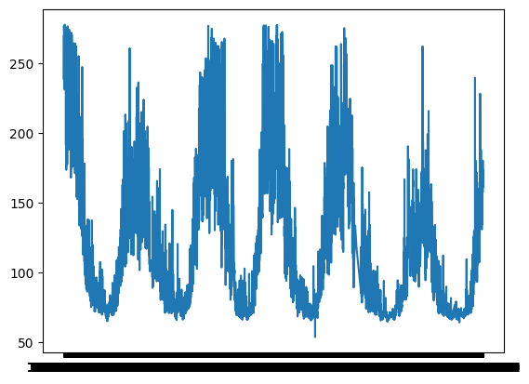
F10.7 forecasting
F10.7 radio flux is a measurement of the intensity of solar radio emissions with a wavelength of 10.7 cm (a frequency of 2800 MHz) . It is a continuous value and has data records from 1947

Slide 4
Data Source
GFZ German Research Center for Geosciences provides archived records of F10.7 , Kp and many other space weather data parameters
Data cleaning
Data extracted from the above source has uninterupted and uncorrupted data therefore little to no efforts for data cleaning are required
data spliting - we perform train test split based on literature knowledge
train - 1979 - 2003
test - 2003 - 2014
reformatting - the data need to be restructured from seires form to a form that supports supervised learning (achieved by extracting data samples using a sliding window of size 27 )
Data preprocessing

Slide 5
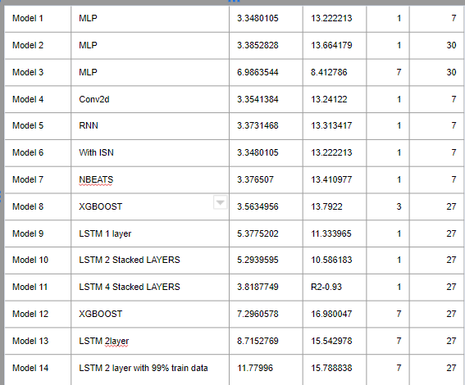
A bird eye view of all the model built and thier performences

Slide 6
Main papers refered and implemented
Predicting the Daily 10.7-cm Solar Radio Flux Using the Long Short-Term Memory Method
proposes a single layered LSTM architecture
Implemented and working
Forecasting the 10.7-cm Solar Radio Flux Using Deep CNN-LSTM Neural Networks
proposes a stacked CNN LSTM architecture
Implemented and working
A New Approach for the 10.7-cm Solar Radio Flux Forecasting: Based on Empirical Mode Decomposition and LSTM
proposes a LSTM architecture baed on EMD decomposition of series data
we observed that the model does not converge to the data

Slide 7
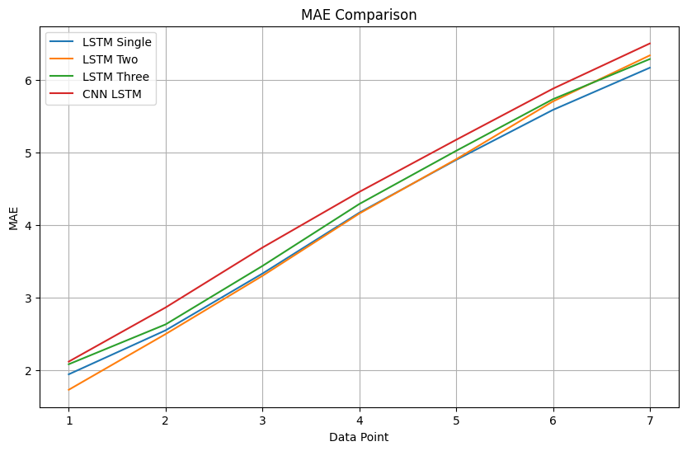
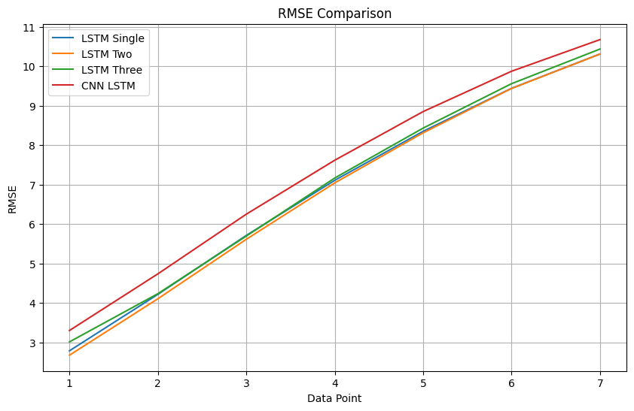
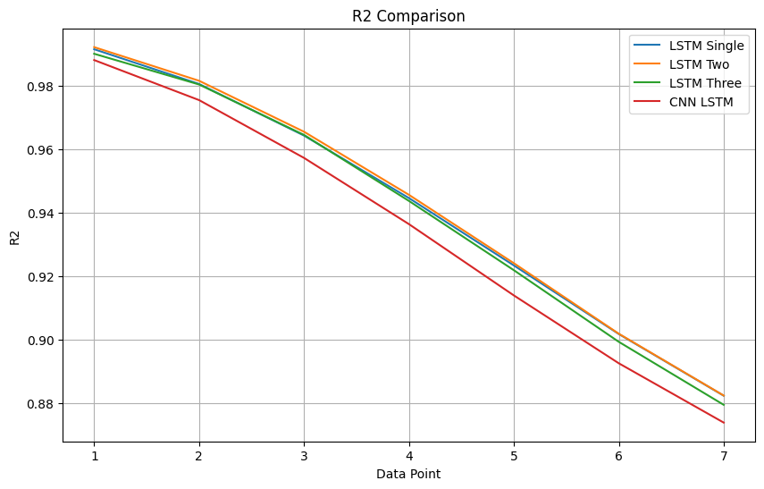
We note that the 2 layered LSTM model consistantly out performs all other model architectures all metrics

Slide 8
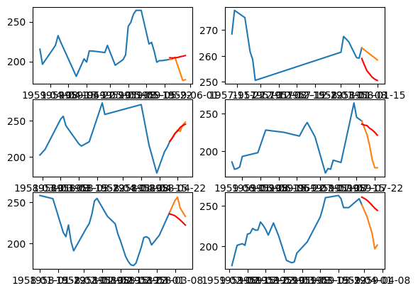
A finer look at model predictions
the plot shows a closer look at the predictions of the model

